Slide 1
What is Agile?
Agile is a Project Management and software development approach that aims to be more effective.
It focuses on delivering smaller pieces of work regularly instead of one big launch.
This allows teams to adapt to changes quickly and provide customer value faster.

Slide 2
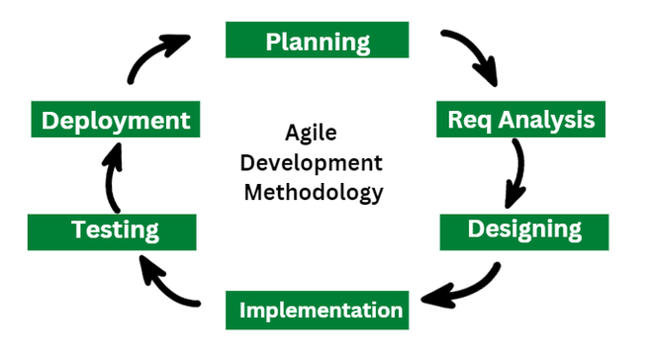

Slide 3
Agile | Waterfall
.Client input is required throughout the product development. | Client input is required only after completing each phase.
Changes can be made at any stage | Changes cannot be made after the completion of a phase.
A Small team is sufficient for Agile project management. | It requires a large team.

Slide 4
